Slide 1
Introduction to Computer Organization & Architecture, Overview of Digital System
(Lecture 1-2)

Slide 2
What is Computer Architecture?
Computer architecture is a group of rules, orders, and processes that describe the functionality and performance of computer systems. Basically, it deals with the operational behaviour of computer systems.
What is Computer Organisation?
Computer Organisation is also known as Microarchitecture. It provides deep knowledge of functionality, structuring, internal working, and implementation of a computer system. The role of computer organisation comes after Computer architecture.

Slide 3
Difference between Computer Architecture and Computer Organisation
S. No. | Computer Architecture | Computer Organisation
1. | They explain what a computer does. | They explain how a computer actually does it.
2. | They majorly focus on the functional behaviour of computer systems. | They majorly focus on the structural relationship and deep knowledge of the internal working of a system.
3. | Computer architectures deal with high-level design matters. | They deal with low-level design matters.
4. | It comes before computer organisation. | It comes after the architecture part.
5. | It covers logical functions, such as registers, data types, instruction sets, and addressing modes. | It covers physical units like peripherals, circuit designs, and adders.

Slide 4
Introduction to Computer Organization and Architecture
Computer Organization and Architecture
Computer Architecture refers to those attributes of a system that have a direct impact on
the logical execution of a program. Examples:
o the instruction set
o the number of bits used to represent various data types
o I/O mechanisms
o memory addressing techniques
Computer Organization refers to the operational units and their interconnections that
realize the architectural specifications. Examples are things that are transparent to the
programmer:
o control signals
o interfaces between computer and peripherals
o the memory technology being used

Slide 5
Continue..
Architecture is those attributes visible to the programmer
Instruction set, number of bits used for data representation, I/O mechanisms,
addressing techniques. e.g. Is there a multiply instruction? Organization is how features are implemented.
Control signals, interfaces, memory technology. e.g. Is there a hardware multiply unit or is it done by repeated addition?
All Intel x86 family share the same basic architecture
The IBM System/370 family share the same basic architecture

Slide 6
Continue..
Structure and Function
• Structure is the way in which components relate to each other
• Function is the operation of individual components as part of the structure
• All computer functions are:
o Data processing: Computer must be able to process data which may take a wide
variety of forms and the range of processing.
o Data storage: Computer stores data either temporarily or permanently.
o Data movement: Computer must be able to move data between itself and the
outside world.
o Control: There must be a control of the above three functions.

Slide 7
Functional View of Computer
Fig1.2: Processing from i/o to storage
Fig 1.2: Processing from storage to i/o
Fig 1.1: Functional view of a computer

Slide 8
Continue..
Four main structural components:
o Central processing unit (CPU)
o Main memory
o I / O
o System interconnections
• CPU structural components:
o Control unit
o Arithmetic and logic unit (ALU)
o Registers
o CPU interconnections

Slide 9
Introduction to Digital System
A Digital system is an interconnection of digital modules and it is a system that manipulates discrete elements of information that is represented internally in the binary form.
Now a day’s digital systems are used in wide variety of industrial and consumer products such as automated industrial machinery, pocket calculators, microprocessors, digital computers, digital watches, TV games and signal processing and so on.
Characteristics of Digital systems
Digital systems manipulate discrete elements of information.
• Discrete elements are nothing but the digits such as 10 decimal digits or 26 letters of alphabets and so on.
• Digital systems use physical quantities called signals to represent discrete elements.
• In digital systems, the signals have two discrete values and are therefore said to be binary.
• A signal in digital system represents one binary digit called a bit. The bit has a value either 0 or 1.
Analog systems vs Digital systems
Analog system process information that varies continuously i.e; they process time varying signals that can take on any values across a continuous range of voltage, current or any physical parameter.
Digital systems use digital circuits that can process digital signals which can take either 0 or 1 for binary system.

Slide 10
Continue..
Advantages of Digital system over Analog system
1. Ease of programmability
The digital systems can be used for different applications by simply changing the program without additional changes in hardware.
2. Reduction in cost of hardware
The cost of hardware gets reduced by use of digital components and this has been possible due to advances in IC technology. With ICs the number of components that can be placed in a given area of Silicon are increased which helps in cost reduction.
3.High speed
Digital processing of data ensures high speed of operation which is possible due to advances in Digital Signal Processing.
4. High Reliability
Digital systems are highly reliable one of the reasons for that is use of error correction codes.
5. Design is easy
The design of digital systems which require use of Boolean algebra and other digital techniques is easier compared to analog designing.
6. Result can be reproduced easily
Since the output of digital systems unlike analog systems is independent of temperature, noise, humidity and other characteristics of components the reproducibility of results is higher in digital systems than in analog systems.

Slide 11
Continue..
Disadvantages of Digital Systems
Use more energy than analog circuits to accomplish the same tasks, thus producing more heat as well.
• Digital circuits are often fragile, in that if a single piece of digital data is lost or misinterpreted the meaning of large blocks of related data can completely change.
• Digital computer manipulates discrete elements of information by means of a binary code.
• Quantization error during analog signal sampling.

Slide 12
NUMBER SYSTEM
Number system is a basis for counting varies items. Modern computers communicate and operate with binary numbers which use only the digits 0 &1. Basic number system used by humans is Decimal number system.
For Ex: Let us consider decimal number 18. This number is represented in binary as 10010.
We observe that binary number system take more digits to represent the decimal number. For large numbers we have to deal with very large binary strings. So this fact gave rise to three new number systems.
i) Octal number systems
ii) Hexa Decimal number system
iii) Binary Coded Decimal number(BCD) system To define any number system we have to specify.
To define any number system we have to specify
Base of the number system such as 2,8,10 or 16.
The base decides the total number of digits available in that number system.
First digit in the number system is always zero and last digit in the number system is always base-1.

Slide 13
Binary number system:
The binary number has a radix of 2. As r = 2, only two digits are needed, and these are 0 and 1. In binary system weight is expressed as power of 2.
The left most bit, which has the greatest weight is called the Most Significant Bit (MSB). And the right most bit which has the least weight is called Least Significant Bit (LSB).

Slide 14
Continue..
The human beings use decimal number system while computer uses binary number system.
Therefore it is necessary to convert decimal number system into its equivalent binary.
i) Binary to octal number conversion
ii) Binary to hexa decimal number conversion

Slide 15
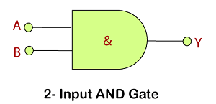
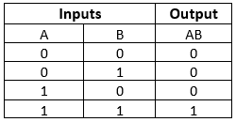
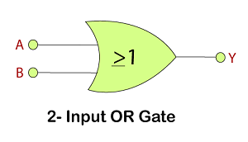
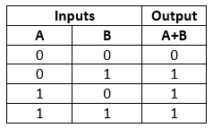
Digital Logic gates

Slide 16
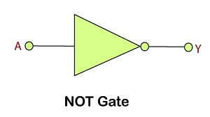
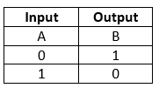
Continue..

Slide 17
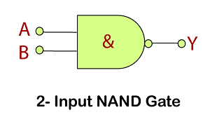
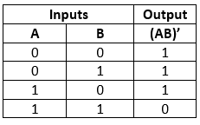
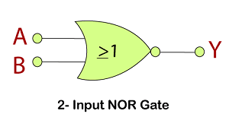
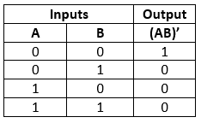
Universal gates

Slide 18
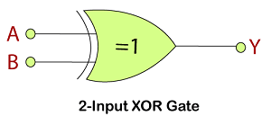
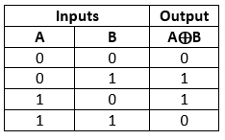
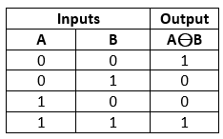
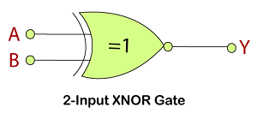
Additional gates

